Slide 1
Forecasting Overdose Incidents for Rapid Actionable Data for Opioid Response in Kentucky
Aaron Mullen
Application Programmer Analyst
Center for Applied Artificial Intelligence
Aaron.Mullen@uky.edu

Slide 2
RADOR-KY
Rapid Actionable Data for Opioid Response in Kentucky
Data collection from a variety of sources
Statewide surveillance system to monitor and respond to opioid crisis
Predictive analytics and machine learning to forecast future trends

Slide 3
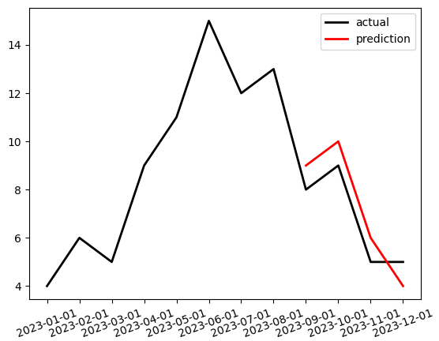
Time Series Forecasting
Predict future values of time-dependent data
Use past values of target series to understand trends
Can use additional variables to aid in predictions (covariates)

Slide 4
Time Series Forecasting Applications
Used in a variety of fields
Finance, statistics, weather, retail, etc.
Application: opioid overdoses throughout Kentucky
Accurate forecasting can identify at-risk areas and changes in trends
State government agencies can prepare and distribute resources effectively
Notes:
Kentucky has 5th largest drug od fatality rate, and 79% involve opioid substances

Slide 5
Time Series Forecasting Goal
Target series- emergency medical services (EMS) responses to suspected opioid overdose incidents
Data is available from Jan 2017 – present
To understand time series better, can perform decomposition
Group all Kentucky incidents together, aggregated monthly

Slide 6
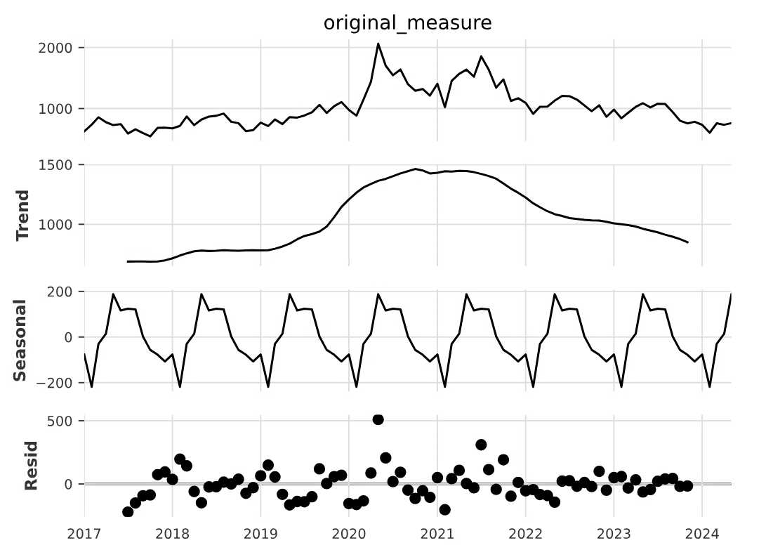
Time Series Decomposition

Slide 7
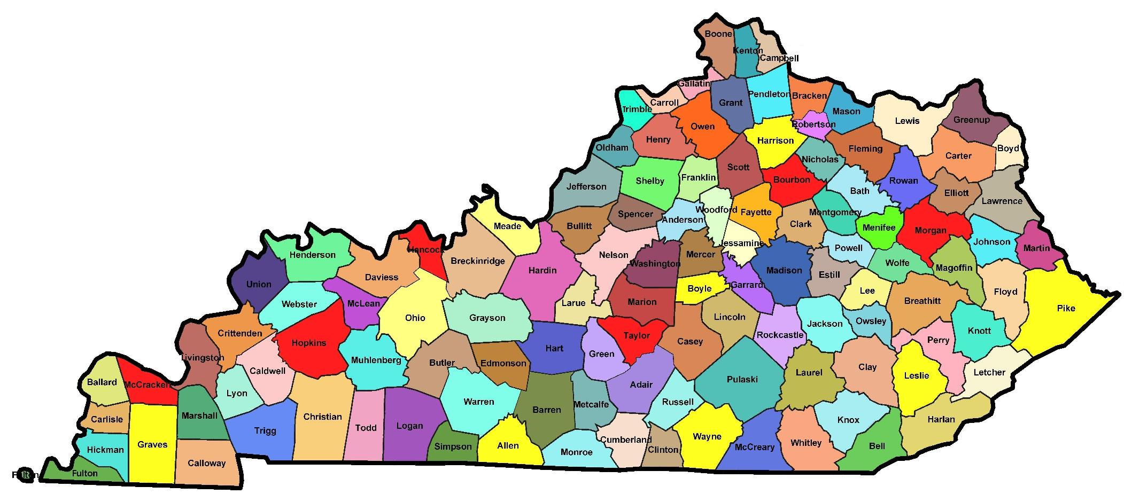
Geographical Units
Statewide counts can provide a helpful overall view, but aren’t as practical for intervention and response
EMS events can be grouped by state, county, zip code, census tract, block group, or block
Anything smaller than county will be too sparse to use

Slide 8
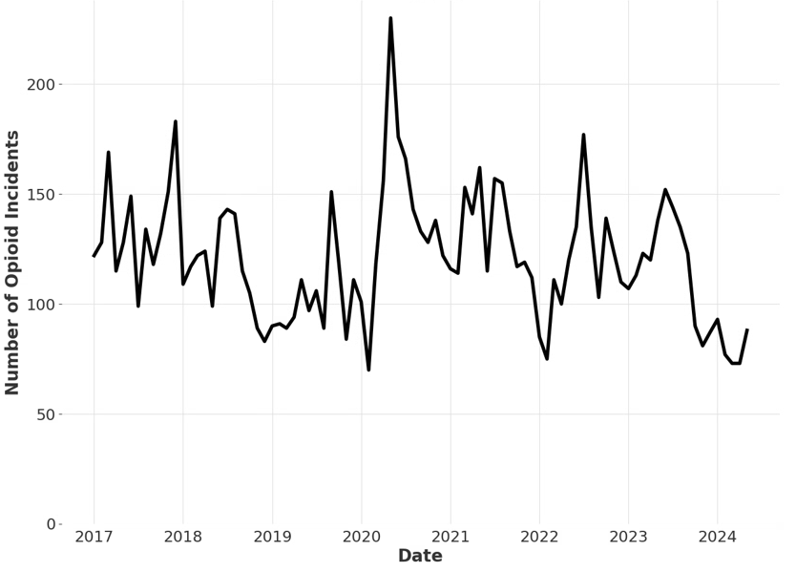
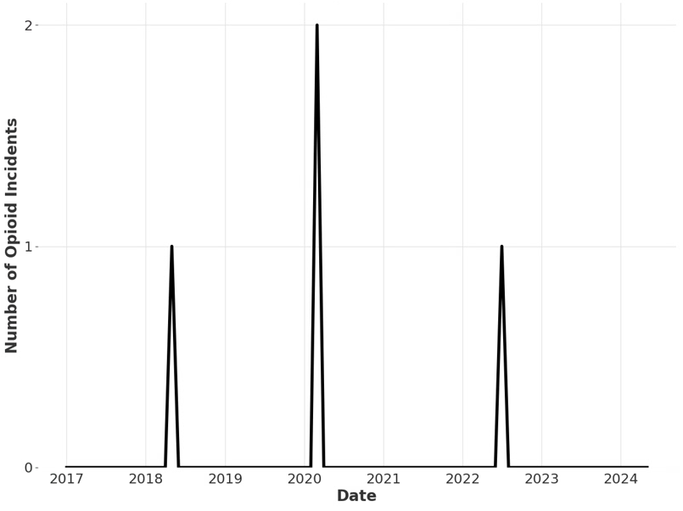
Geographical Units
Data sparsity- many 0’s in data
Difficult for models to forecast accurately
Predict 0 all the time and usually correct
Notes:
Smaller counties more susceptible to randomness, larger counties can follow trends and patterns better

Slide 9
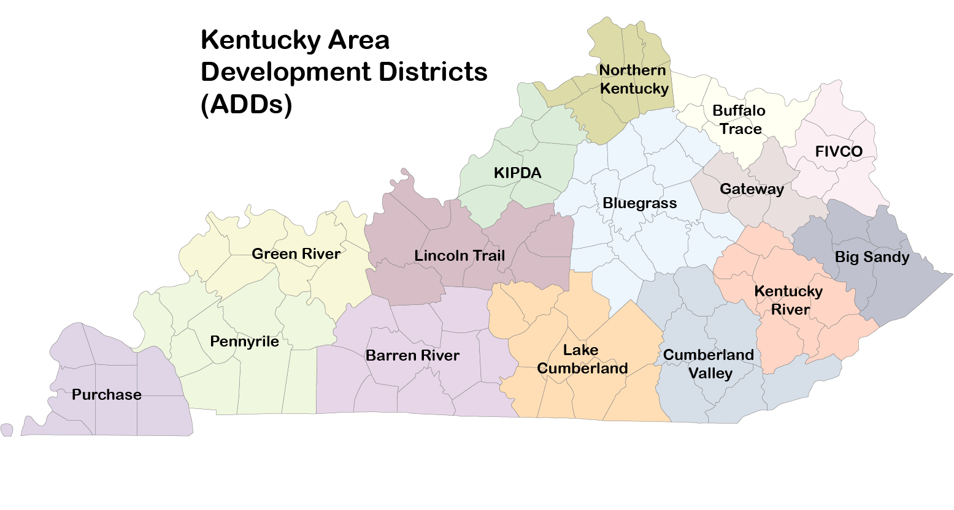
Geographical Units
Group areas by Area Development Districts instead

Slide 10
Temporal Units
Monthly chosen over weekly or yearly
Same reasons as for geographical units
Weekly may be helpful in some circumstances

Slide 11
Covariates
Weather
Drug Seizures
SDOH
Medicaid Claims
Intake/Release
Naloxone Distribution
Related Groupings
Additional variables/features that model can use in predictions
Different types:
Future- available into the future at prediction time
Past- only historical data is known
Static- does not change over time
Base covariates- month and season

Slide 12
Covariates
Weather
Drug Seizures
SDOH
Medicaid Claims
Intake/Release
Naloxone Distribution
Related Groupings
Temperature, precipitation, sunshine data
Gathered at ADD level, generalized to counties if necessary
Can be reasonably predicted into future
Data source: NOAA/OpenMeteo

Slide 13
Covariates
Weather
Drug Seizures
SDOH
Medicaid Claims
Intake/Release
Naloxone Distribution
Related Groupings
Police drug seizures
Where they were seized
What substances tested positive
Limited to only opioid substances
Data source: Kentucky State Police

Slide 14
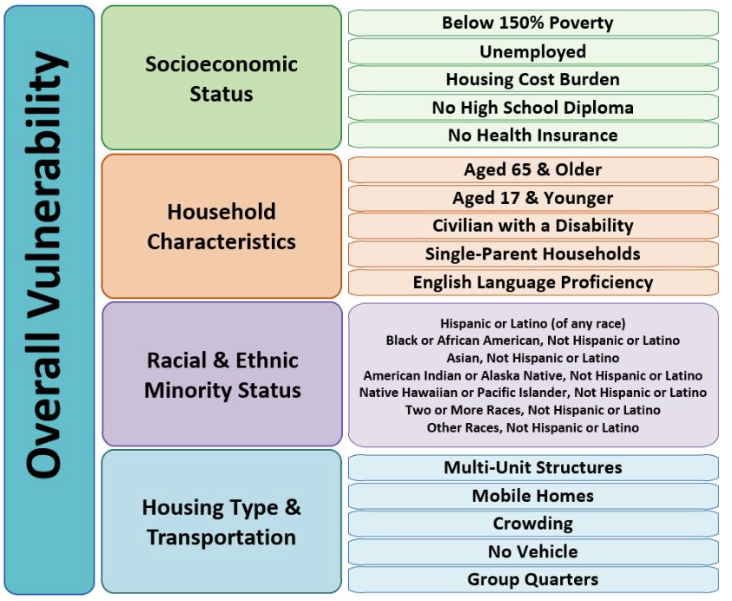
Covariates
Weather
Drug Seizures
SDOH
Medicaid Claims
Intake/Release
Naloxone Distribution
Related Groupings
Social Determinants of Health (SDOH)
Static covariates
Data source: CDC/ATSDR
Notes:
Unemployment rate
Proportion of cost-burdened housing
Vehicle access
Municipal housing rates
Centers for Disease Control and Prevention and Agency for Toxic Substances and Disease Registry Social Vulnerability Index

Slide 15
Covariates
Weather
Drug Seizures
SDOH
Medicaid Claims
Intake/Release
Naloxone Distribution
Related Groupings
Kentucky Medicaid claims
Number of individuals diagnosed with OUD
Number of individuals receiving treatment for OUD
Number of individuals screened for substance use
Number of individuals connected to an opioid-related ED visit
Data source: Kentucky Department for Medicaid Services

Slide 16
Covariates
Weather
Drug Seizures
SDOH
Medicaid Claims
Intake/Release
Naloxone Distribution
Related Groupings
Inmate intake and release data for those with substance use risk
Risk level on a scale of 1 to 5
Weighted average of risk levels is calculated for each month
Data source: Kentucky Department of Corrections

Slide 17
Covariates
Weather
Drug Seizures
SDOH
Medicaid Claims
Intake/Release
Naloxone Distribution
Related Groupings
Naloxone distribution counts for each county
Data source: Kentucky Public Health Association

Slide 18
Covariates
Weather
Drug Seizures
SDOH
Medicaid Claims
Intake/Release
Naloxone Distribution
Related Groupings
Lagged values of correlated counties
Some counties will precede the trends of other counties
Spikes in overdoses in one area may follow spikes in another area
Determine which counties’ trends align best, and use to aid in predictions
Opioid Incidents
Date

Slide 19
Models
Several models tested to produce predictions
Models must be able to support past, future, and static covariates
Three primary models:
Histogram-based Gradient Boosting Regressor
N-Linear LSTF Model
Temporal Fusion Transformer

Slide 20
Gradient Boosting
Simplest tested model
Builds ensemble of decision trees
Uses gradient descent to optimize each tree
Final prediction is sum of outputs
Not time series specific
Error
Iterations

Slide 21
N-Linear
Simple, one-layer neural network, built for time series forecasting
Zeng, A., Chen, M., Zhang, L., & Xu, Q. (2022). Are Transformers Effective for Time Series Forecasting?. arXiv preprint arXiv:2205.13504.

Slide 22
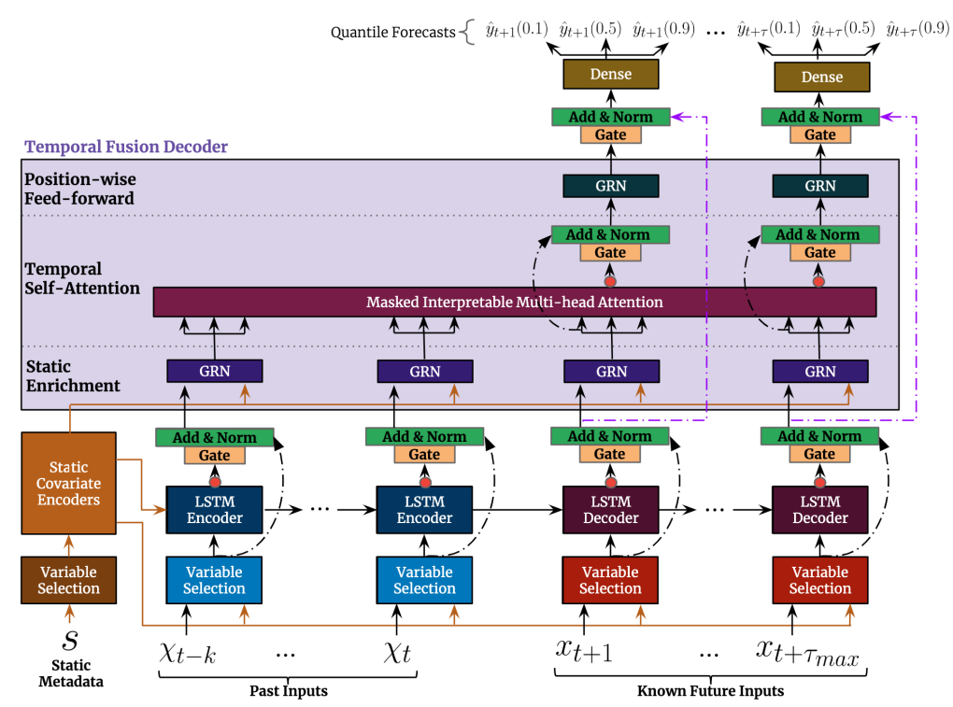
Temporal Fusion Transformer
Most complex model chosen
Deep learning architecture specifically designed for time series
Multiple layers, self-attention mechanism
Weigh importance of data at different time steps
Lim B, Arık S, Loeff N, Pfister T. Temporal Fusion Transformers for interpretable multi-horizon time series forecasting. International Journal of Forecasting. 2021 Oct;37(4):1748–64. doi:10.1016/j.ijforecast.2021.03.012

Slide 23
Preprocessing
Normalize each grouping to between 0 and 1
Fill missing values
Many covariates have mismatched time frame availability
Dropping missing timesteps would lose too much data
Constant fill values used to fill holes, plus binary flag variable

Slide 24
Training
All data grouped at monthly level
Geographically grouped at both county and ADD levels
All models support multivariate predictions
Only one model is trained on all counties/ADDs
10% holdout for test set
Each covariate tested independently, as well as combinations
Base covariates of month and season included in every run

Slide 25
Results- Grouping Comparison
Grouping at ADD level has consistently lower error than grouping at county level
Less sparse data likely influences better predictions
Model | Avg. RMSE (County Level) | Avg. RMSE (ADD Level) | % Decrease in RMSE
N-Linear | 0.1864 | 0.1384 | 25.75%
Gradient Boosting Regression | 0.1961 | 0.1685 | 14.07%
Temporal Fusion Transformer | 0.2616 | 0.2154 | 17.66%

Slide 26
Results- Model Comparison
N-Linear model performs the best overall
TFT may be too complex for relatively small dataset
N-Linear strikes balance between complexity and generalizability
Model | Avg. RMSE (County Level) | Avg. RMSE (ADD Level) | Best RMSE (County Level) | Best RMSE (ADD Level)
N-Linear | 0.1864 | 0.1384 | 0.1729 | 0.1202
Gradient Boosting Regression | 0.1961 | 0.1685 | 0.1792 | 0.1394
Temporal Fusion Transformer | 0.2616 | 0.2154 | 0.2418 | 0.1878

Slide 27
Results- Covariate Comparison
Most useful covariates overall are drug seizures, Medicaid, and Naloxone
Some more impactful at ADD level (Naloxone, drug seizures)
Some more impactful at county level (SDOH, related groupings)
Covariate | Avg. RMSE (County Level) | Avg. RMSE (ADD Level)
Base | 0.2172 | 0.1751
Weather | 0.2164 | 0.1773
Drug Seizures | 0.2085 | 0.1641
SDOH | 0.2120 | 0.2014
Medicaid | 0.2059 | 0.1744
Intake | 0.2101 | 0.1770
Naloxone | 0.2398 | 0.1656
Related Groupings | 0.2077 | 0.1793

Slide 28
Results- Best Performers
After each covariate was tested independently, combinations of best choices were tried to maximize accuracy
Too many covariates will typically worsen performance
Model | Best RMSE (County Level) | Best Covariates (County Level) | Best RMSE (ADD Level) | Best Covariates (ADD Level)
N-Linear | 0.1729 | Drug seizures, Medicaid | 0.1202 | Drug seizures
Gradient Boosting Regression | 0.1792 | Drug seizures, Medicaid | 0.1394 | Naloxone
Temporal Fusion Transformer | 0.2418 | Drug seizures, Medicaid | 0.1878 | Drug seizures, Related groupings

Slide 29
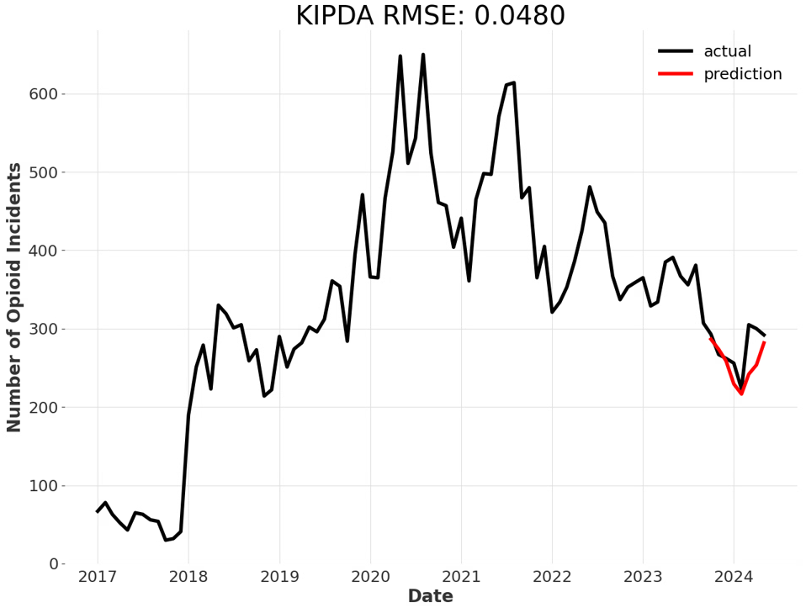
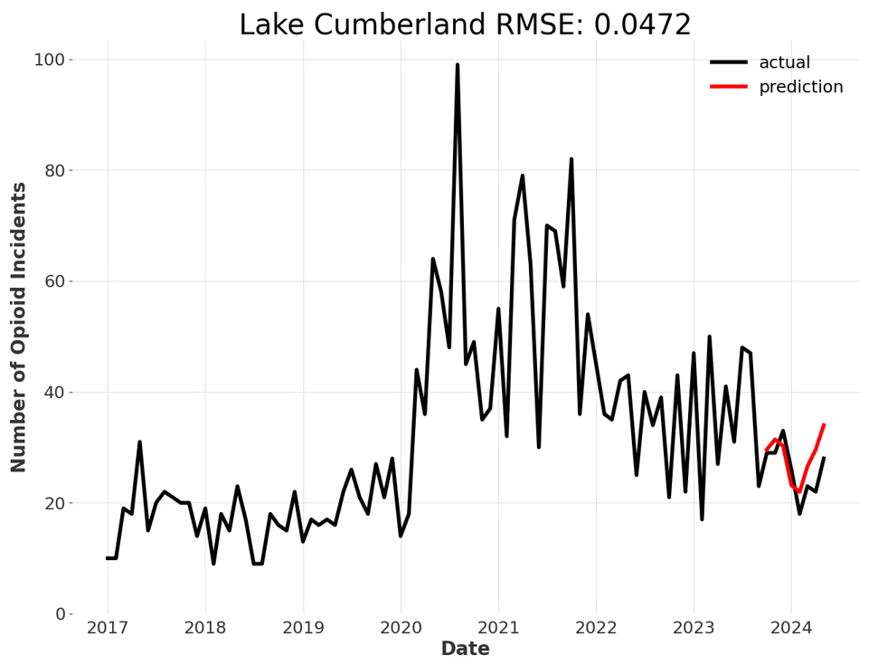
Results- Plots

Slide 30
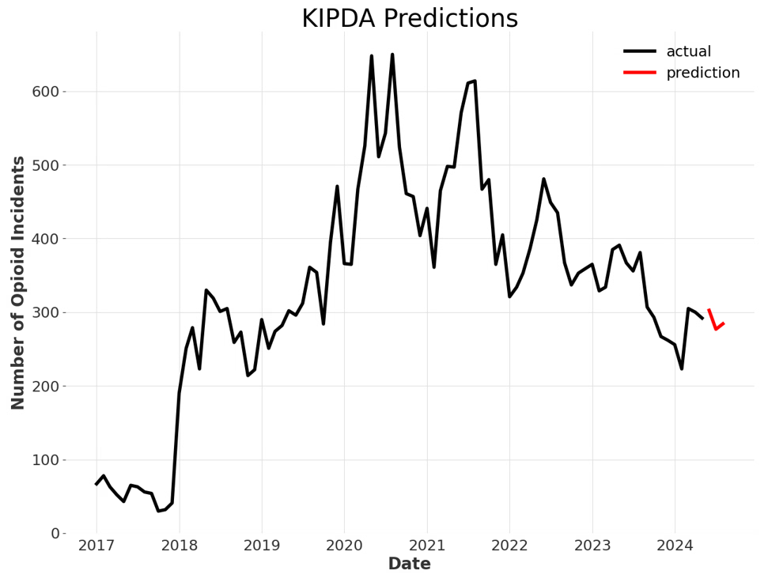
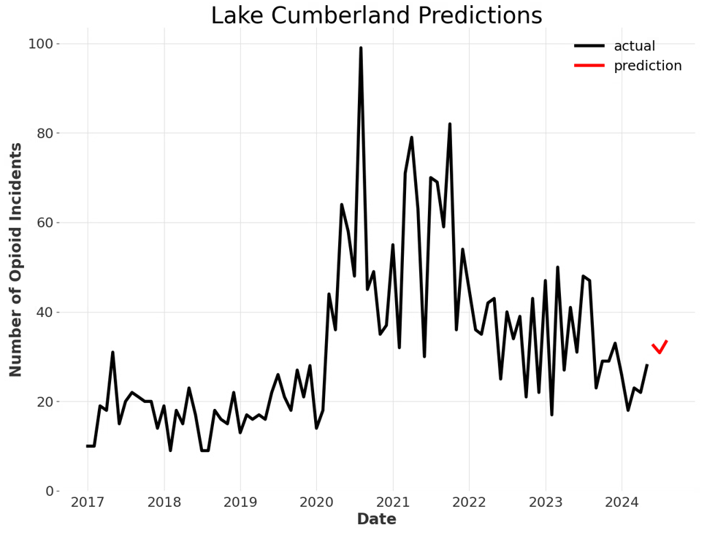
Results- Plots

Slide 31
Historical Predictions
Can use expanding window to visualize predictions over time
Train model on first 24 months, predict for next 3 months
Then incorporate next 3 months into training and predict the following 3 months
Repeat continuously until entire time series has been used

Slide 32
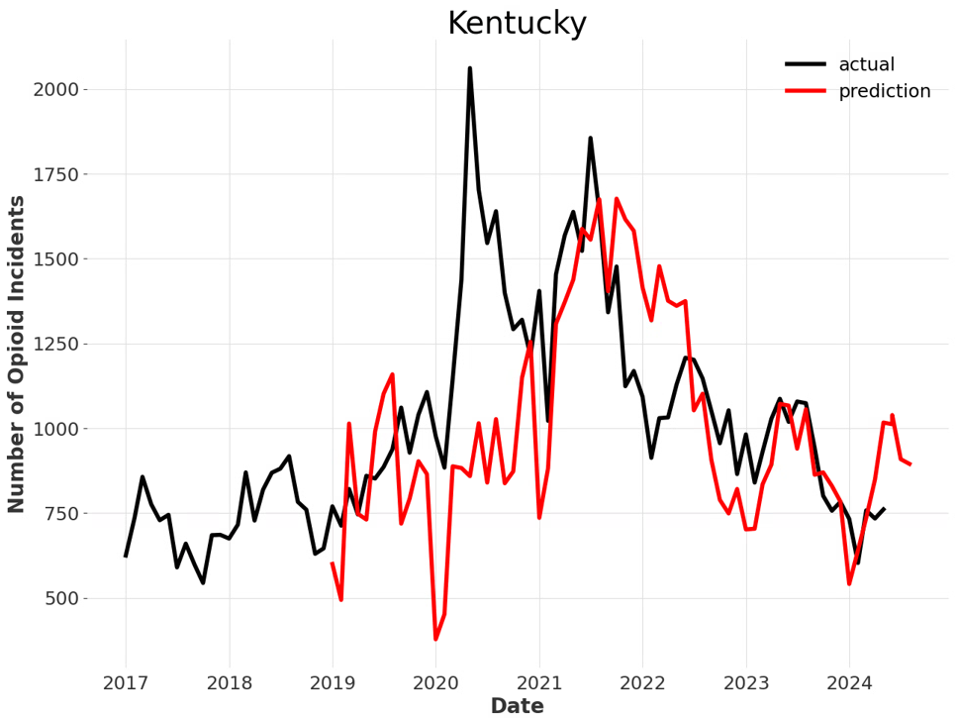
Historical Predictions

Slide 33
Predicting Other Variables
Other target variables can be forecasted with similar methods
Opioid deaths
Individuals receiving treatment (such as buprenorphine products)
Some harder to forecast than others due to sparsity and different relationships with covariates

Slide 34
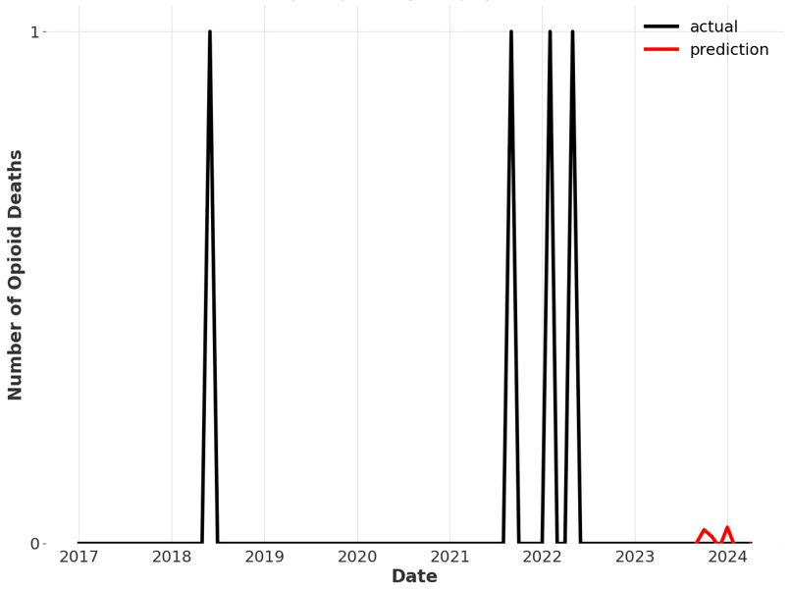
Sparsity and RMSE
RMSE is not perfect error metric for comparison
Manual review is necessary to determine usefulness of predictions
Low RMSE (0.0177) does not mean valuable

Slide 35
Future Work
Continue to test new models and methods
New data sources are always being added and tested

Slide 36
Acknowledgement
This research was supported by the National Institute on Drug Abuse (NIDA) of the National Institutes of Health under award number R01DA057605. The content is solely the responsibility of the authors and does not necessarily represent the official views of the National Institutes of Health.
We thank the Kentucky Office of Vital Statistics, Kentucky Department for Public Health, Kentucky Medical Examiners’ Office, the Kentucky Board of Emergency Medical Services, and the Kentucky State Police for their support for this study and providing data.

Slide 37
Questions
https://caai.ai.uky.edu/

